Slide 1
Data Exploration & Preparation
Outliers | Missing values | Features

Slide 2
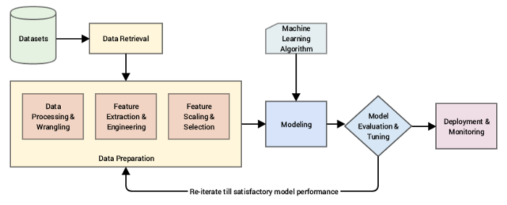
The Process

Slide 3
Data!
Important but with a lot of problems!
Too high variation
Outliers
Missing Values
Variable Selection
Feature Engineering
A lot of variables!
Garbage In, Garbage Out (GIGO).

Slide 4
Data Normalization / Standardization
-50; 10; 1000; 500,000
A lot of variation | too varied to identify any pattern
Let’s normalize it – take log
1.69, 1, 3, 5.69 → Variation Reduced
Let’s Standardize it – take Sigmoid
1.93E-22, 0.99, 1, 1

Slide 5
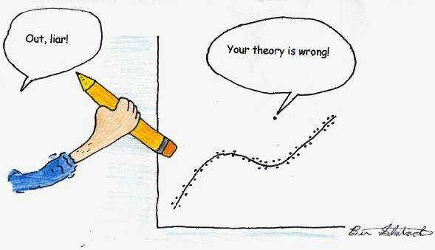
Outliers

Slide 6
Outliers
When you have done everything and accuracy doesn’t improve
An outlier is any data point which differs greatly from the rest of the observations in a dataset.
While analyzing a certain customer’s purchase patterns, it turns out there’s suddenly an entry for a very high value. While most of his/her transactions fall below CAD 1,000, this entry is for CAD 50,000. It could be an electronic item purchase – whatever the reason, it’s an outlier in the overall data.
Reasons –
Perhaps an analyst made an error in the data entry
The machine threw up an error in measurement
The outlier could even be intentional! Some people do not want to disclose their information and hence input false information in forms.

Slide 7
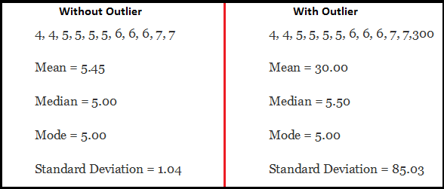
Outliers
Types
Univariate – In a single variable
Multivariate – In multiple variables

Slide 8
Outliers – Not always bad!
They may be facts!
They may be indicating – you need more data!
They may indicate – preferences are shifting – Cohort Studies
Simply removing outliers from your data without considering how they’ll impact the results is a recipe for disaster.

Slide 9
Outliers - Detection
Any value, which is beyond the range of -1.5 x IQR to 1.5 x IQR
Use capping methods. Any value which out of range of 5th and 95th percentile can be considered as outlier
Data points, three or more standard deviation away from mean are considered outlier
Outlier detection is merely a special case of the examination of data for influential data points and it also depends on the business understanding
Bivariate and multivariate outliers are typically measured using either an index of influence or leverage, or distance. Popular indices such as Mahalanobis’ distance and Cook’s D are frequently used to detect outliers.
Visual Methods – Histograms, Box Plots, Scatter Plots etc.

Slide 10
Outliers – Detection through algorithms
PyOD package
Angle Based Outlier Detection (AOBD)
k-Nearest Neighbors Detector
Isolation Forest
Local Outlier Factor
Robust Random Cut Forest
DBScan Clustering
https://towardsdatascience.com/5-ways-to-detect-outliers-that-every-data-scientist-should-know-python-code-70a54335a623
Advanced - https://machinelearningmastery.com/how-to-use-statistics-to-identify-outliers-in-data/

Slide 11
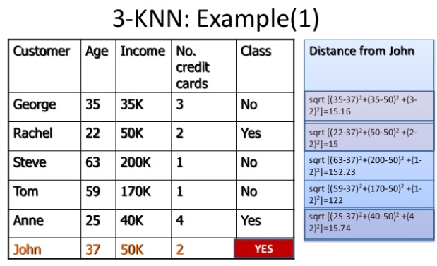
Easiest - kNN

Slide 12
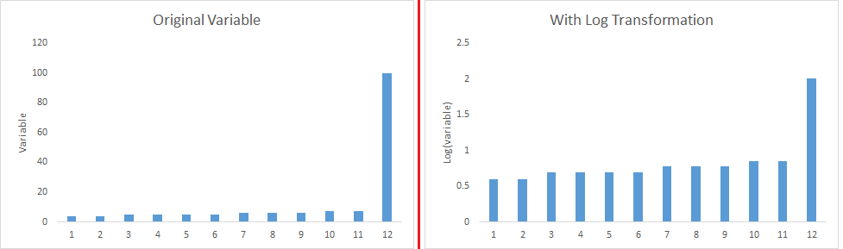
Outliers - Treatment
Delete them!
Log Transform them

Slide 13
Outliers - Treatment
Impute with Mean, Median or Mode
Predictive Models
Create a separate DF of outliers – not very popular

Slide 14
Missing Values - Treatment
System doesn’t understand missing values – computational error
Delete them!
Impute with Mean, Median or Mode
Encode them!
Predictive Models
Rule of thumb – Any columns with missing values > 40% - Delete them
Rule of thumb – Any rows with missing values > 25% - Delete them

Slide 15
Feature Engineering
Feature engineering is the science (and art) of extracting more information from existing data.
You are not adding any new data here, but you are actually making the data you already have more useful.
For example, let’s say you are trying to predict foot fall in a shopping mall based on dates. If you try and use the dates directly, you may not be able to extract meaningful insights from the data.
This is because the foot fall is less affected by the day of the month than it is by the day of the week. Now this information about day of week is implicit in your data. You need to bring it out to make your model better.
This exercising of bringing out information from data in known as feature engineering.
There is NO single “Correct Answer”.

Slide 16
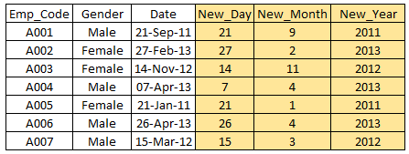
Feature Engineering

Slide 17
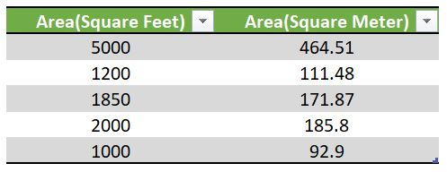
Feature Engineering - Choosing

Slide 18
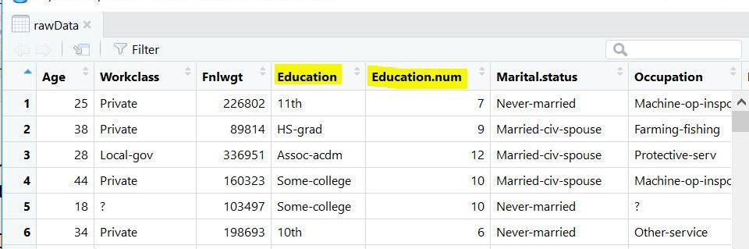
Feature Engineering - Eliminating

Slide 19
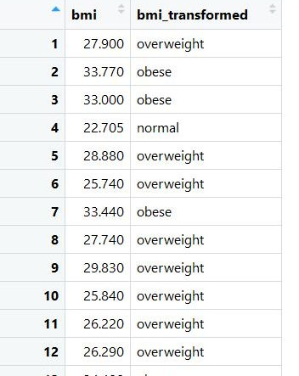
Feature Engineering - Binning

Slide 20
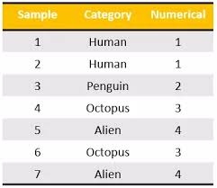
Feature Engineering – One Hot Encoding

Slide 21
All in One Example
https://towardsdatascience.com/feature-engineering-for-machine-learning-3a5e293a5114

